Slide 1
CISM & Peer Support Team
&
Recognizing Symptoms of Post Traumatic Stress Disorder

Slide 2
Why we are here
Discuss the ECCFPD CISM & Peer Support Program
Identify available resources
Answer questions

Slide 3
What we will cover today
Introduce the ECCFPD Critical Incident Stress Management (CISM) Program
Introduce the Peer Support Team, SOP, Supporting Docs
Discuss the CISM Peer Support Statement of Understanding
Introduce the Death & Dying Checklist for the community
Introduce the CISM Team Brochure
Educate about Firefighter Suicide Prevention

Slide 4
What is CISM & Peer Support
Review SOP 13-1

Slide 5
Resources
Peer Support Team
Peer Support Statement of Understanding
Death & Dying Checklist for the community
CISM Team Brochure
MHN- Your Employee Assistance Program
Brochure

Slide 6
Firefighter Suicide Prevention Recognizing Symptoms of Post Traumatic Stress Disorder

Slide 7
You Tube Video
http://youtu.be/uP1OPCax2oQ

Slide 8
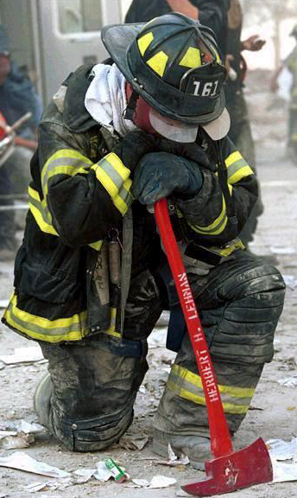
Our Dirty Little Secret
Everyone in the Fire Service will be exposed to a traumatic event sometime in their career
Negative stigma attached to PTSD and mental illness
Employees of Contra Costa Fire Districts have been exposed to the death of a co-worker at least 17 times in the past 10 year
Our responsibility to be vigilant and recognize signs and symptoms of PTSD in each other

Slide 9
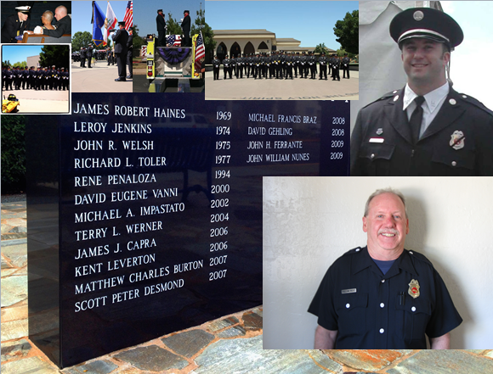

Slide 10
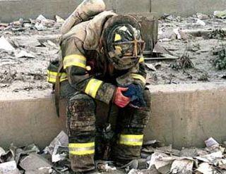
Definitions:
Traumatic incident or critical incident: any event that causes unusually strong emotional reactions that have the potential to interfere with the ability to function normally.
Post Traumatic Stress Disorder: an anxiety disorder that occurs in the aftermath of a traumatic event

Slide 11
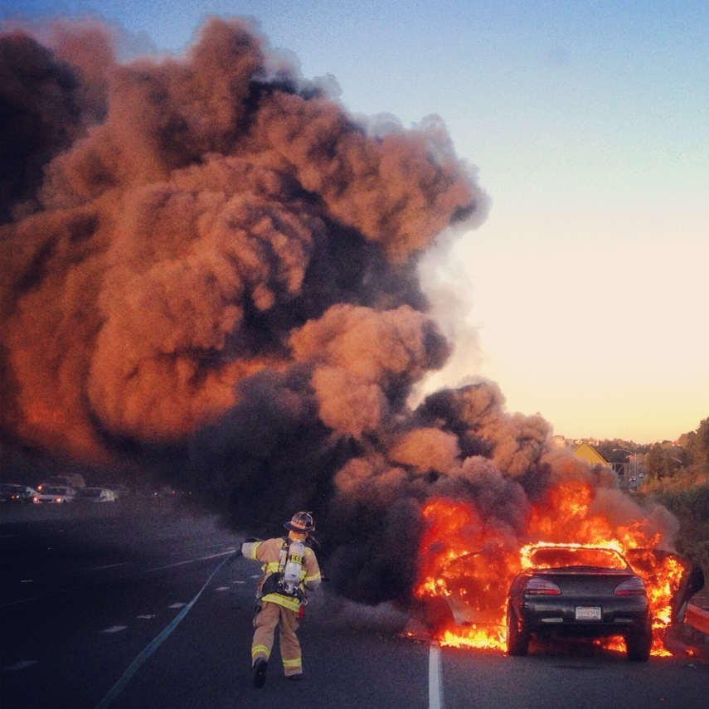
Contributing Factors
Excessive exposure to horrific events
Personal level of involvement in a traumatic event
Sustaining significant physical injury
Strong feeling of personal responsibility for event or intense feelings of guilt
Death of a co-worker or child

Slide 12
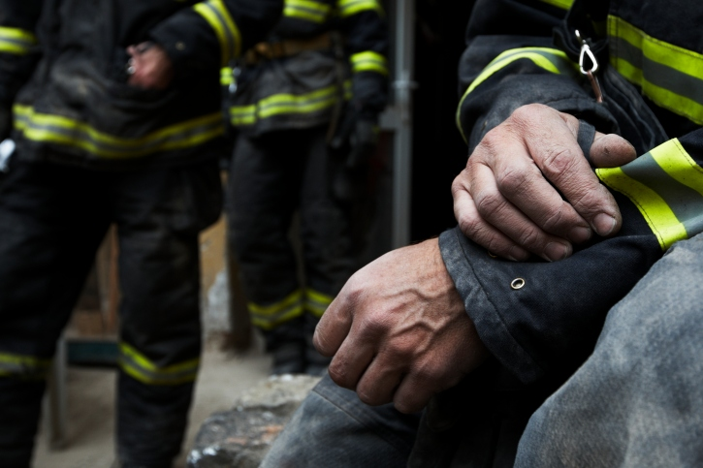
Signs and Symptoms
Restlessness
Sleeplessness
Hyper activity
Inability to relax
Jumpiness
Difficulty concentrating
Mental replays or dreams
Shutting off emotions
Avoiding triggers – people, places
Angry or irritable
Difficulty sleeping
Difficulty concentrating
Always feeling on guard
Very startled when surprised
Feelings of shame, despair, or hopelessness
Difficulty controlling one’s emotions
Problems with family or friends
Impulsive or self-destructive behavior
Changed beliefs or changed personality traits

Slide 13
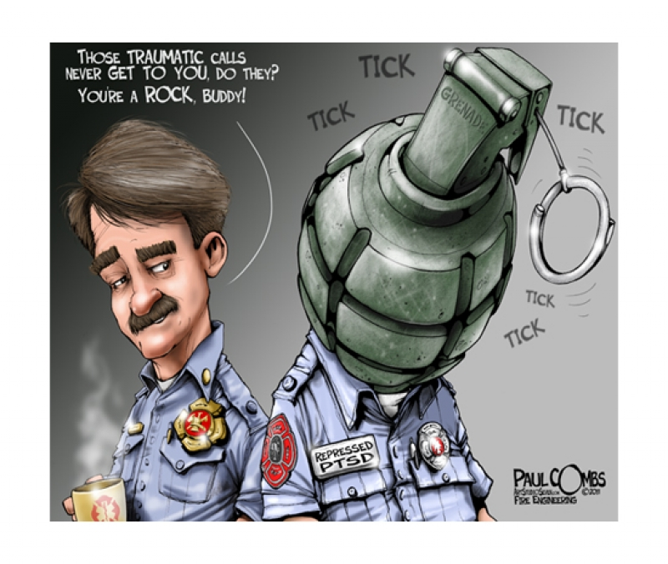

Slide 14
Consequences
Anxiety
Stress
Substance Abuse
Divorce
Depression
Suicide

Slide 15
Binge Drinking
Defined as being legally drunk (BAC > 0.08%)
Common in the fire service - 58% of firefighters
14 times more likely to drive drunk
10% of firefighters drove drunk in the last 30 days
Working with a hang over
Self-destructive behavior
Almost 30% of suicides had alcohol in their system
Viewed as a socially acceptable behavior

Slide 16
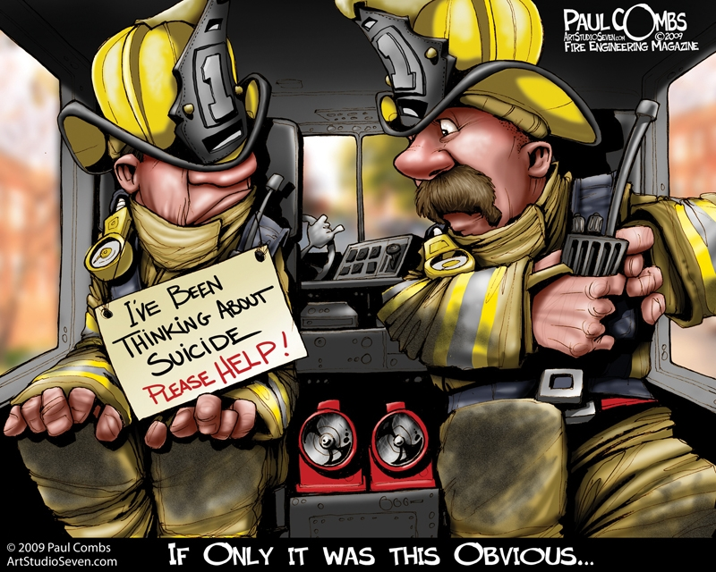

Slide 19
LODD vs Suicide
2012 LODD: 83
2012 Firefighter Suicides: 66
2013 LODD: 101
2013 Firefighter Suicides: 63
2014 LODD: 87
2014 Firefighter Suicides: 89

Slide 20
Warning Signs
Experiencing a change in sleeping habits
Experiencing a change in eating habits
Losing interest in most activities
Performing poorly at work or in school
Giving away prized possessions
Writing a will (with other warning signs)
Feeling excessive guilt or shame
Acting recklessly
Appearing depressed or sad most of the time
Talking or writing about death or suicide
Withdrawing from family and friends
Feeling hopeless
Feeling helpless
Feeling strong anger or rage
Feeling trapped
Experiencing dramatic mood changes
Abusing drugs or alcohol
Exhibiting a change in personality
Acting impulsively

Slide 21
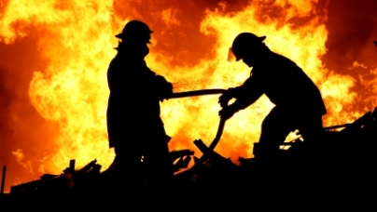
Our Responsibility
Change our culture
Recognize warning signs and symptoms
Critical Incident Stress Debriefing
Reach out and talk it out
Know available resources

Slide 22
Resources
Refer to Handout
Peer Support
Diffusing's / Debriefings
Employee Assistance Program
National Volunteer Fire Council
Firefighter Behavioral Health Alliance
U.S. Department of Health and Human Services
Chaplain Programs
National Programs on Suicide
National Suicide Prevention Lifeline
Counseling Service for Fire Fighters
American Counseling Association
Safe Call Now
National Fallen Firefighters Foundation
American Addiction Centers

Slide 23
Any Questions & Thank You

